Slide 1
A Survey on RRAM Technology and MOS Integration
By Ashton Billings and Jack Walberer

Slide 2
Overview
What is RRAM and what are VCMs in particular?
Why and where would you use RRAM?
How are these devices actually used in CMOS?
Technology dependent challenges (Planar -> FD-SOI -> FinFET)

Slide 3
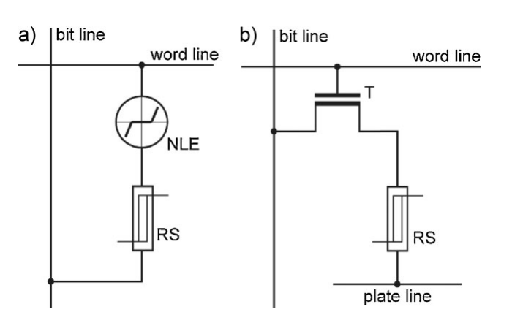
What is RRAM?
RRAM - Resistive Random Access Memory
A form of Non-volatile memory (NVM).
Uses a resistive switching device to store information.
Resistance changes based on voltage applied.
Stores a logic 0 in the high resistance state (HRS) and a logic 1 in the low resistance state (LRS).
Waser, R., Dittmann, R., Staikov, G. and Szot, K. (2009), Redox-Based Resistive Switching Memories – Nanoionic Mechanisms, Prospects, and Challenges. Adv. Mater., 21: 2632-2663. https://doi.org/10.1002/adma.200900375

Slide 4
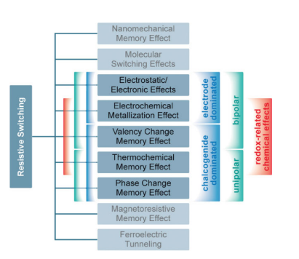
Resistive Switching Devices
Industry has converged to Valence Change Memory’s (VCMs).
HfO₂ and TaOₓ being the front runners.
Waser, R., Dittmann, R., Staikov, G. and Szot, K. (2009), Redox-Based Resistive Switching Memories – Nanoionic Mechanisms, Prospects, and Challenges. Adv. Mater., 21: 2632-2663. https://doi.org/10.1002/adma.200900375

Slide 5
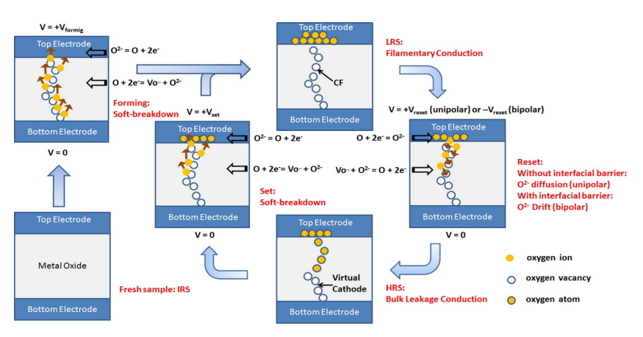
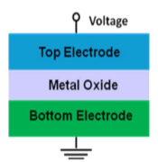
How do VCMs Work?
H. . -S. P. Wong et al., "Metal–Oxide RRAM," in Proceedings of the IEEE, vol. 100, no. 6, pp. 1951-1970, June 2012, doi: 10.1109/JPROC.2012.2190369.

Slide 6
Why RRAM?
Replacement for eFlash, an embedded NVM (eNVM), which doesn’t scale below 28nm.
Back-end-of-line (BEOL) integratable, allowing for higher density.
Could even be used to replace volatile memory (VM) like SRAM and DRAM.
Hellenbrand, M., Teck, I. & MacManus-Driscoll, J.L. Progress of emerging non-volatile memory technologies in industry. MRS Communications 14, 1099–1112 (2024). https://doi.org/10.1557/s43579-024-00660-2
H. . -S. P. Wong et al., "Metal–Oxide RRAM," in Proceedings of the IEEE, vol. 100, no. 6, pp. 1951-1970, June 2012, doi: 10.1109/JPROC.2012.2190369.
Notes:
3

Slide 7
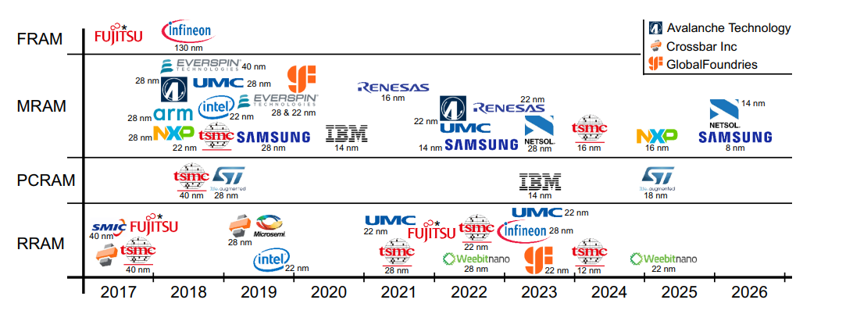
Industry Trends
Hellenbrand, M., Teck, I. & MacManus-Driscoll, J.L. Progress of emerging non-volatile memory technologies in industry. MRS Communications 14, 1099–1112 (2024). https://doi.org/10.1557/s43579-024-00660-2
Notes:
3

Slide 8
Industry Trends
TSMC - HfO₂ based in 40nm, 28nm, and 22nm. Demoed in 12nm FinFet in 2024.
Intel - Demonstrated 22nm FinFET RRAM with a TaOₓ based oxide.
IBM - Looking into using both TaOₓ/HfO₂ for analog-in-memory compute.
Hellenbrand, M., Teck, I. & MacManus-Driscoll, J.L. Progress of emerging non-volatile memory technologies in industry. MRS Communications 14, 1099–1112 (2024). https://doi.org/10.1557/s43579-024-00660-2
Notes:
3

Slide 9

Benchmarking Memory Technology
SRAM
DRAM
Flash
(NAND)
Flash (NOR)
RRAM
Volatile
Volatile
Volatile
Non-Volatile
Non-Volatile
Non-Volatile
Cell Size
~50 F²
~6 F²
~4 F²
~10F²
~6–12 F²
Read Speed
Fast
Fast
Slow
Fast
Fast
Write Speed
Fast
Fast
Slow
Slow
Medium
Endurance
Unlimited
~10¹⁵
~10⁴–10⁵
~10⁴–10⁵
~10⁶–10⁹
Write Voltage
Vdd
Vdd
~20V
~20V
Vdd + boost ~2V
Write Granularity
Per-bit
Per-bit
Block erase req.
Block erase req.
Per-bit
On Chip Usage
Yes
No
No
Yes
Yes

Slide 10
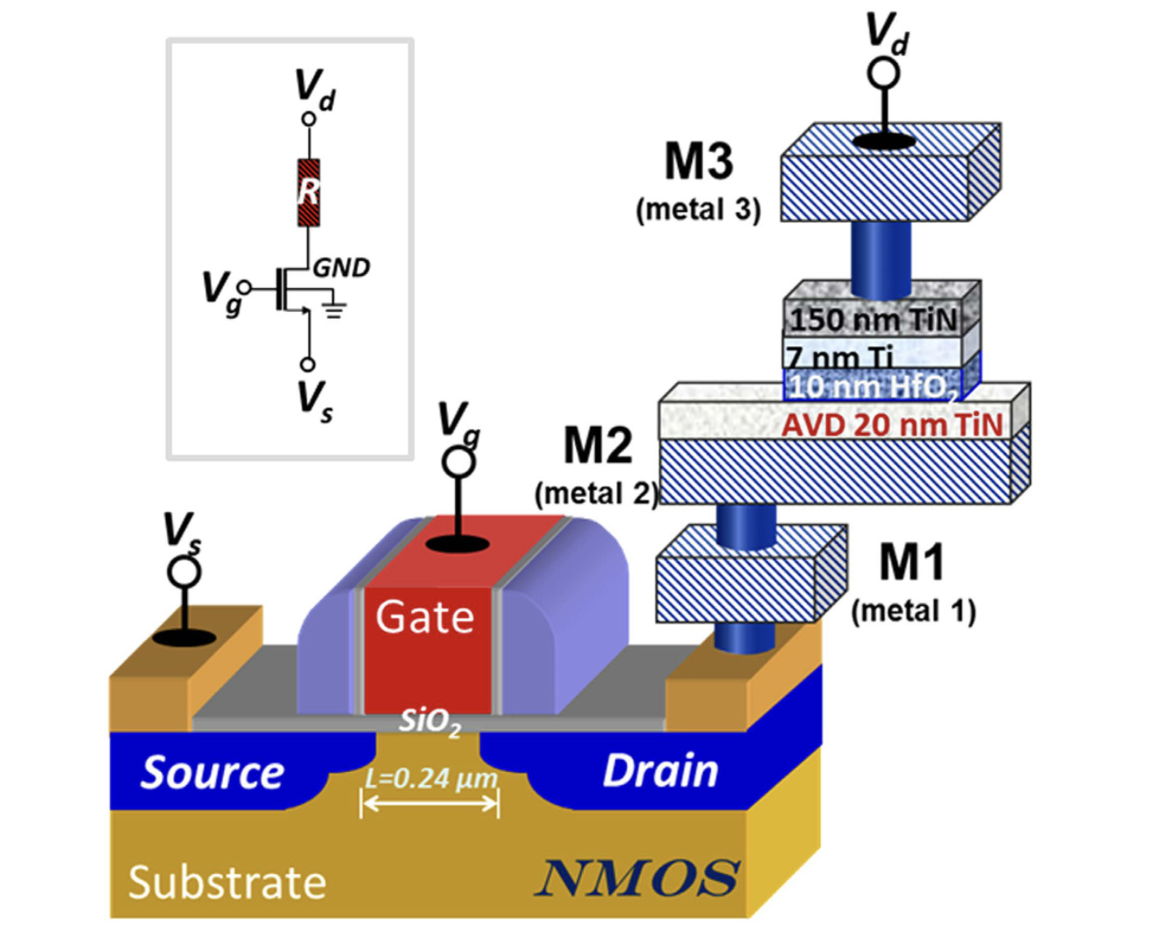
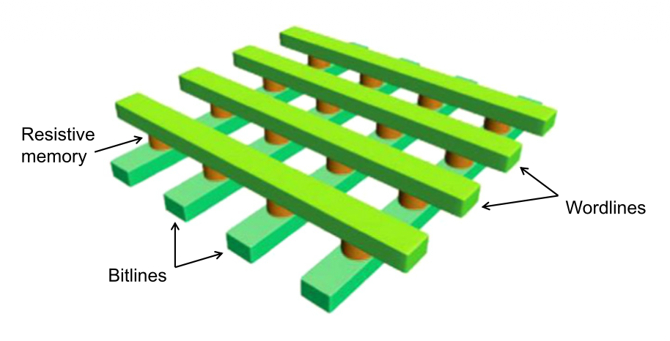
Competing RRAM Architectures: Operating Conditions
[ add 1T1R schematic here ]
[ add crossbar schematic here ]
Operation | 1T1R | Crossbar Array
READ | BL: 0.3-0.4 V, SL: 0 V, WL: VDD MOSFET: triode sense I_cell vs. I_ref HRS/LRS 10–1000× in HfO₂ | WL = -Vr/2, BL = +Vr/2 I_cell vs I_ref Sneak: I = (N–1)·Vr / (2·R_LRS) HRS/LRS must exceed array fan-out N for read margin
WRITE SET | BL: 2–2.5 V, SL: 0 V, WL: VDD MOSFET: saturation — used to limit sudden current jump ~ R_LRS = Vc/Icc | WL = +Vw/2, BL = −Vw/2 Cannot limit sudden jump when channel conducts N-1 nodes on the WL and BL are half selected
WRITE RESET | SL: 1.5 V, BL: 0 V, WL: VDD MOSFET: saturation | BL = +Vw/2, WL = −Vw/2 N-1 nodes on the WL and BL are half selected
Niu et al., Sci. Rep. 6:28155 (2016) D. Ielmini, "Resistive switching memories based on metal oxides: mechanisms, reliability and scaling," Semiconductor Science and Technology, vol. 31, no. 6, p. 063002, 2016.

Slide 11
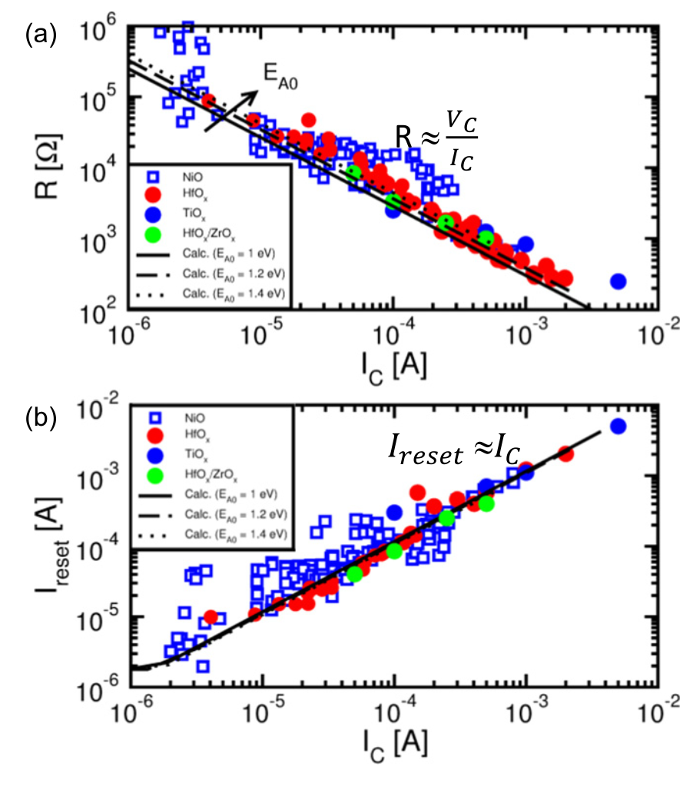
Why 1T1R?
RRAM Requirement | Transistor Design
Limit Icc for SET (0-1) and Forming Voltage | Built in headroom to be in saturation during forming Size so: Ids = Icc = ½µnCox(W/L)(Vgs − Vt)²
Suppress Leakage Current from other Cells: Isneak = (N−1) · Vr / (2 · R_LRS) | Limit DIBL Low SS = (kT/q)ln(10)(1 + Cd/Cox)
Ensure Clean Read | Limit R_on of transistor R_LRS>>R_on
D. Ielmini, "Resistive switching memories based on metal oxides: mechanisms, reliability and scaling," Semiconductor Science and Technology, vol. 31, no. 6, p. 063002, 2016.

Slide 12
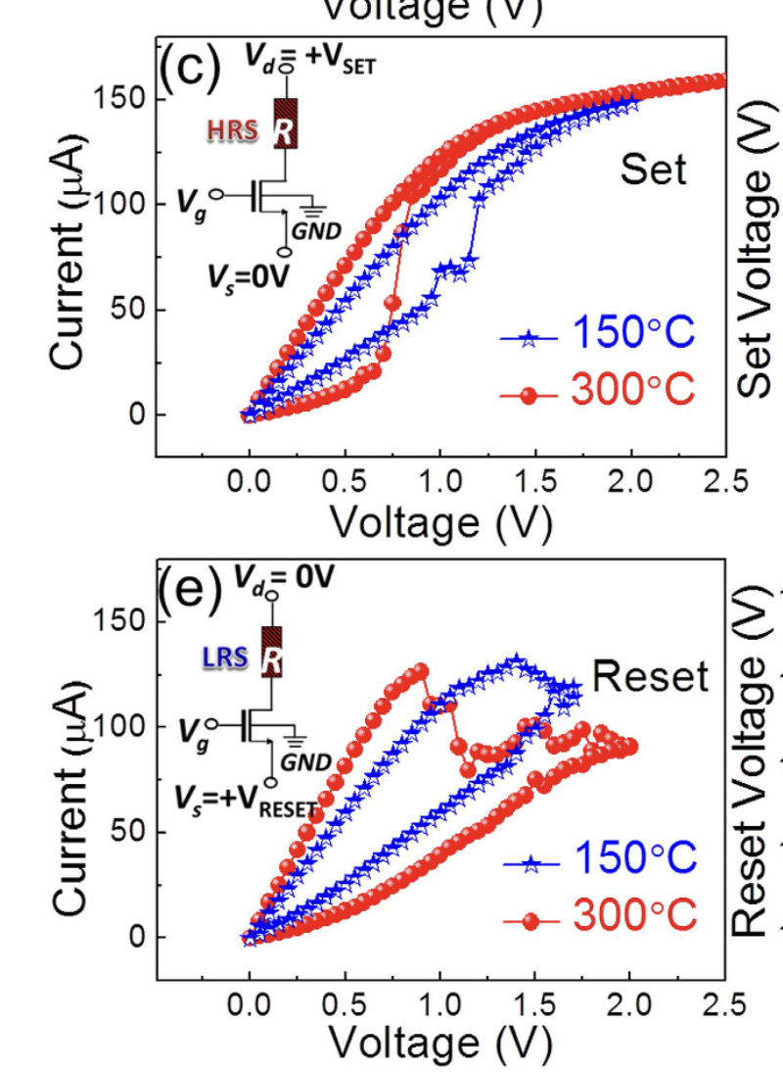
Planar CMOS with RRAM
Sizing the Select Transistor
Series circuit constraint:
Vbl = VRRAM + Vds
Saturation:
Vds > (Vgs − Vt) so Vbl − VSET > (Vgs − Vt)
W/L sizing from saturation model:
Ids = ½μnCox(W/L)(Vgs − Vt)² = Icc
LRS resistance:
RLRS = Vc / Icc (Vc = 0.4 V for HfO₂)
Ron = L / [μnCox · W · (Vgs − Vt)] < RLRS
Niu 2016
W = 1.14 μm, L = 0.24 μm
Vg = 0.9 V Icc = 10 μA
VSET = 0.8–1.1 V, VRESET = 1.0–1.5 V
RLRS = 0.4 V / 10 μA = 40 kΩ
Ron = 200 Ω < 40 kΩ
Forming: 3.2–4.0 V on BL
Niu, G., Kim, H.-D., Roelofs, R., Perez, E., Schubert, M. A., Zaumseil, P., Costina, I., & Wenger, C. (2016). Material insights of HfO₂-based integrated 1-transistor-1-resistor resistive random access memory devices processed by batch atomic layer deposition. Scientific Reports, 6, 28155.

Slide 13
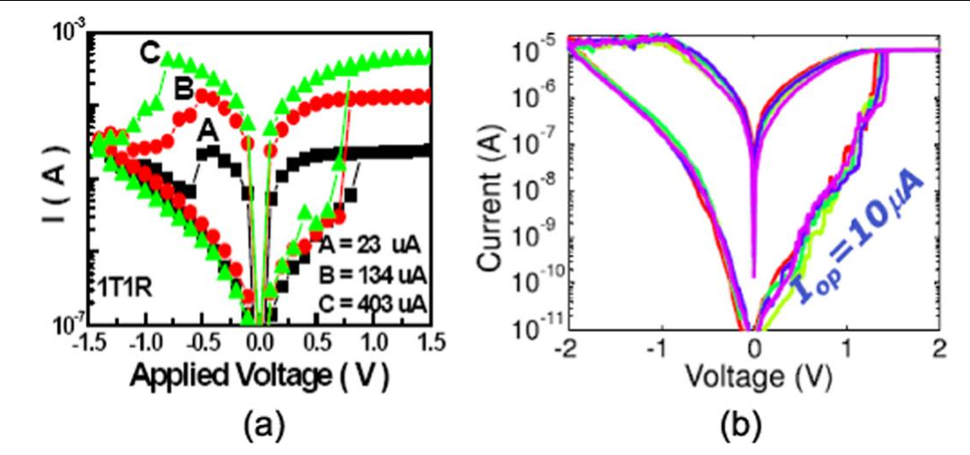
Planar, FDSOI, FinFET Comparison RRAM
Parameter
Planar Bulk
FD-SOI
FinFET
VDD
1.0 V
0.9–1.0 V
0.8–0.9 V
Icc Control
W/L + Vg
W/L + Vg + BG
Nfg + Vg
SS (mV/dec)
80–100
65–75
~65
Min. cell area
0.06 μm²
0.066 μm²
0.022 μm²
Forming headroom
OK
Possible charge pump needed
Charge pump req
In Production eRRAM
TSMC 28nm
STMicro/GF
TSMC 12nm
D. Ielmini, Semicond. Sci. Technol. 31:063002 (2016), Fig. 5

Slide 14
Questions

